Slide 1
Lecture 5 –Stacks, Queues

Slide 2
Stacks
Linear list.
One end is called top.
Other end is called bottom.
Additions to and removals from the top end only.

Slide 3
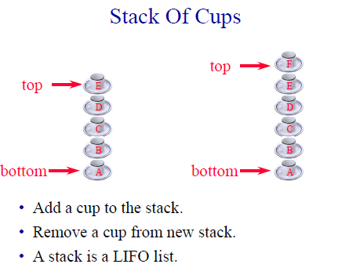

Slide 4
Stack- ADT
Stack is a special kind of list in which all insertions and deletions occur at one end, called the top.
Stack ADT is a special case of the List ADT.
Also called LIFO list or a pushdown list.
Typical Stack ADT Operations:
1. makenull (S) creates an empty stack
2. top (S) returns the element at the top of the stack. Same as retrieve (first (S), S)
3. pop (S) deletes the top element of the stack. Same as deletes (first (S), S)
4. push (x, S) Insert element x at the top of stack S. Same as Insert(x, first (S), S)
5. empty (S) returns true if S is empty and false otherwise
Stack is a natural data structure to implement subroutine or procedure

Slide 5
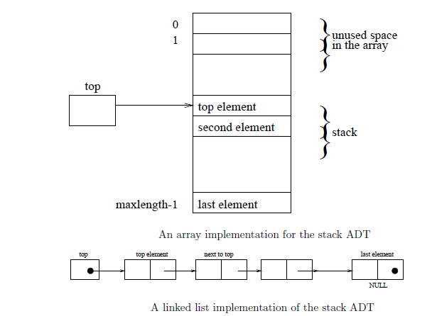

Slide 6
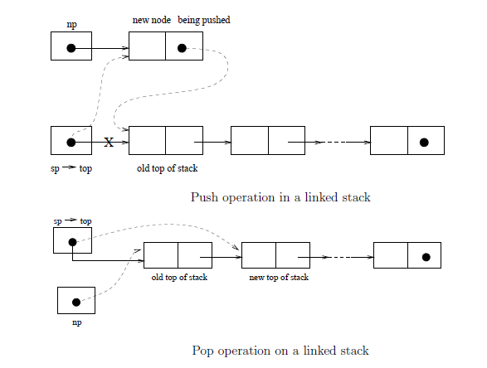

Slide 7
public interface Stack
{
public boolean empty();
public Object peek(); --- returns the top element but does not remove it
public void push(Object theObject);
public Object pop();
}

Slide 8
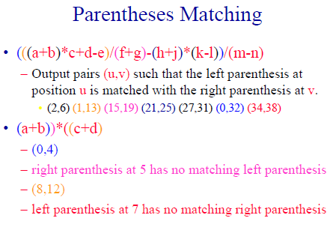

Slide 9
Algorithms
Parenthesis matching
scan expression from left to right
when a left parenthesis is encountered, add its position to the stack
when a right parenthesis is encountered, remove matching position from stack
Example

Slide 10
Polish Notation
Parenthesis free notation
Order of execution is determined by the positions of operators and operands
A+( B*C) -- infix notation
*+ABC
(A+B)*C =[+AB]*C = *+ABC
(A+B)/(C-D) = [+AB]/[-CD] = /+AB-CD
Reverse: AB+, CD-, EF*, GH/

Slide 11
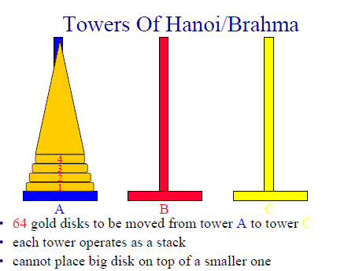

Slide 12
Tower of Hanoi
FUNCTION MoveTower(disk, source, dest, spare):
IF disk == 0 THEN: move disk from source to dest
ELSE
MoveTower(disk - 1, source, spare, dest);
move disk from source to dest
MoveTower(disk - 1, spare, dest, source)
END
Generalize the same to K Disks

Slide 13
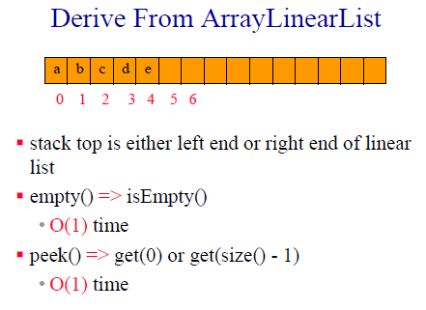
Analysis

Slide 14
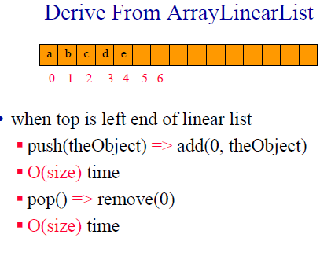

Slide 15
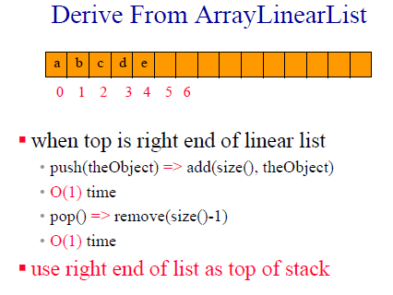

Slide 16
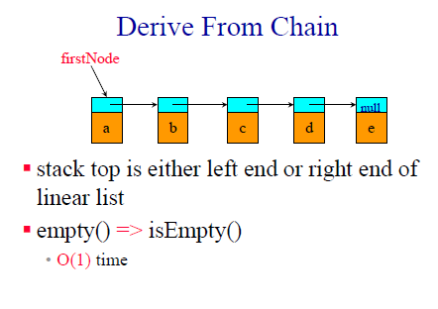

Slide 17
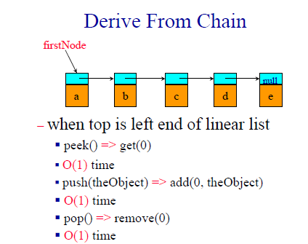

Slide 18
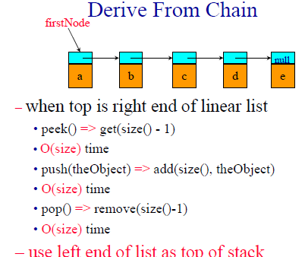

Slide 19
Realizing Efficient implementations
In programming Languages -- Realize efficient implementations -- using Arrays etc

Slide 20
Queues
A queue is a special kind of a list in which all items are inserted at one end (called the rear or the back or the tail) and deleted at the other end (called the front or the head)
Useful in
simulation
breadth-first search in graphs
tree and graph algorithms

Slide 21
Queue ADT
The Queue ADT is a special case of the List ADT, with the following typical operations
1. makenull (Q)
2. front (Q) ≡ retrieve (first (Q), Q)
3. enqueue (x, Q) ≡ insert (x, end(Q), Q)
4. dequeue (Q) ≡ delete (first (Q), Q)
5. empty (Q)
Implementation : Pointers, Circular array, Circular linked list

Slide 22
Circular Array Implementation
Rear of the queue is somewhere clockwise from the front
To enqueue an element, we move rear one position clockwise and write the element in that position
To dequeue, we simply move front one position clockwise
Queue migrates in a clockwise direction as we enqueue and dequeue
emptiness and fullness to be checked carefully.

Slide 23
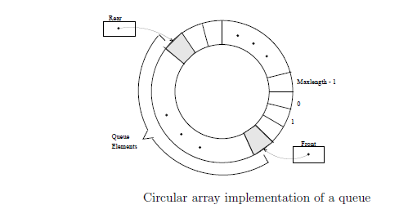

Slide 24
Circular Linked List Implementation
A linked list in which the node at the tail of the list, instead of having a null pointer, points back to the node at the head of the list.
Thus both ends of a list can be accessed using a single pointer.
If we implement a queue as a circularly linked list, then we need only one pointer namely tail, to locate both the front and the back.

Slide 25
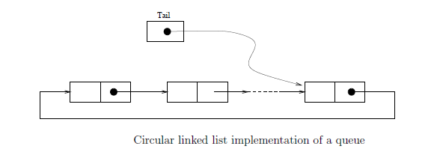

Slide 26
